Slide 1
Welcome to
AI with Deep learning
Developed by Christopher Watkins, Zongyuan Ge and Gin Tan 2019
Updated by Mitchell Hargreaves using content by Titus Tang 2020

Slide 2
Part 1 Itinerary
Time | Event
13:00 – 13:30 | Lecture 1 – Deep Learning Revision
13:30 – 13:45 | Lecture 1 – TensorFlow vs PyTorch
13:45 – 15:00 | Workshop 1 – Deep Learning with PyTorch
15:00 – 15:30 | Lecture 2 Pretrained Models
15:30 – 16:00 | Homework and Question session

Slide 3
Workshop Content – Part 1
Revise the principles of Deep Learning
Discuss the differences between PyTorch and Tensorflow
Implement Neural Networks with PyTorch
Discuss using transfer learning with more advanced models such as ResNet

Slide 4
Assumed Knowledge
Basic math and calculus.
Basic Python programming skills.
Intro to Deep Learning and TensorFlow

Slide 5
Deep Learning Revision
Slides developed by Titus Tang
Notebooks from ‘Intro to Deep Learning with PyTorch’ on Udacity by Facebook AI

Slide 6
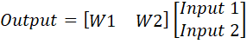
Modelling a perceptron
Input 1
W1
+
Output
In matrix form
Input 2
W2

Slide 7
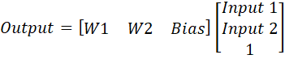
Adding a Bias
Input 1
W1
+
Output
In matrix form
Input 2
W2
Bias

Slide 8
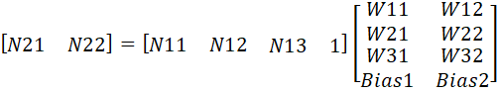
Multilayer Perceptron
...
N11
W11
W12
N21
W21
In matrix form
...
N12
W22
N22
W31
N13
W32
# of inputs
# of nodes

Slide 9
Training a perceptron
Input 1
W1
Calculate the difference between the label (truth) and the output.
This is the loss.
Adjust the weights (behaviour) so that the output equals the label.
You are minimising the loss.
+
Output
Label
Input 2
W2
-
Loss

Slide 10
Gradient Descent
Loss
Weight value

Slide 11
Backpropagation using Gradient Descent
0.7 -> 0.78
0.56+(-0.12) = 0.44
0.624+(-0.104) = 0.52
0.8
Input 1
W1
+
Output
Label
1.0
0.4
Input 2
W2
-
-0.3 -> -0.26
Loss
0.56 -> 0.48
Learning rate
0.1
Loss has reduced from 0.56 to 0.48

Slide 12
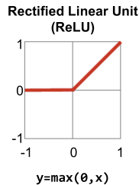
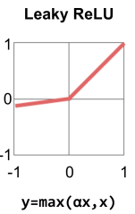
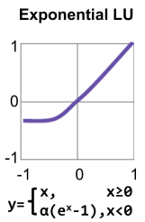
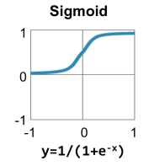
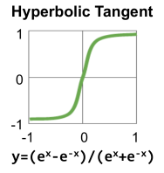
Activation Functions
Introduces nonlinearities to the network.
Allows for the modelling of more complex non-linear functions.
Most popular is the ReLU.

Slide 13
Training Loop
Calculate network outputs (Forward pass)
Calculate Loss
Calculate Gradients (Backward pass)
Update weights
Continue for all data
Each group of data is called a batch
One run through of the dataset is called an epoch

Slide 14
Validation Loop
Calculate network outputs (Forward pass)
Calculate loss and validation metrics
Update metrics
Continue for all data
The weights are not updated during validation
Validation will often involve additional metrics not used in training

Slide 15
TensorFlow and PyTorch
Developed by Mitchell Hargreaves 2020

Slide 16
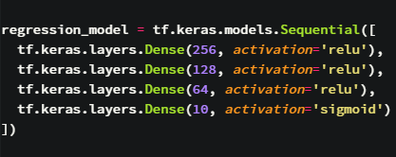
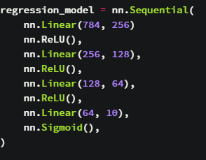
Defining a model with Sequential
Keras
PyTorch

Slide 17
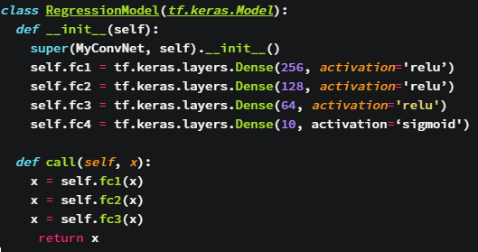
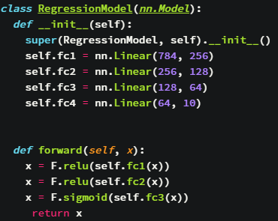
Defining a model with Sequential
TensorFlow
PyTorch

Slide 18
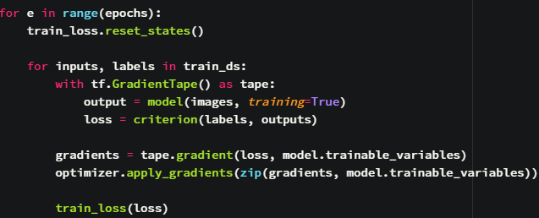
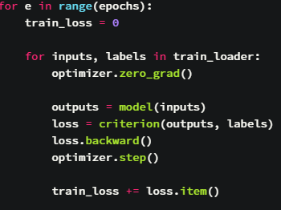
Defining a model with Sequential
TensorFlow
PyTorch

Slide 19
Pretrained Models
Developed by Titus Tang and Mitchell Hargreaves 2020

Slide 20

Building a Convolutional Neural Net
Convolutions to find features, activations to filter good features, pooling to select the best features.
Repeat stacking of layers to find features of features -> high level features.

Slide 21
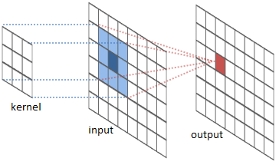
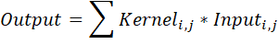
Convolutions
The kernel represents the pattern to be detected.
The more the input matches the kernel, the more positive the output response would be.
Convolutions are pattern detectors.

Slide 22
Convolution Example
Input patch
Kernel
Output
10 | 6 | 6
0 | 10 | 6
0 | 0 | 10
1 | 0.5 | 0.5
-1 | 1 | 0.5
-1 | -1 | 1
*
=
39
Good match
6 | 6 | 10
6 | 10 | 0
10 | 0 | 0
1 | 0.5 | 0.5
-1 | 1 | 0.5
-1 | -1 | 1
*
=
8
Poor match
0 | 0 | 0
6 | 6 | 6
10 | 10 | 10
1 | 0.5 | 0.5
-1 | 1 | 0.5
-1 | -1 | 1
*
=
-7
Poor match

Slide 23
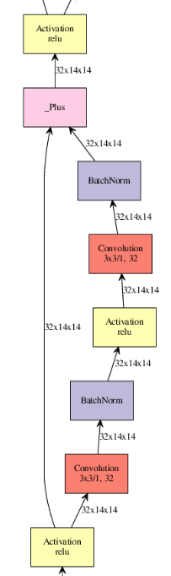
Residual Networks - Resnet
The right branch contains the typical layers of a conv-net.
The left branch allows the backpropagated errors to flow directly through without being diminished through the layers on the right.
Avoids the vanishing gradient problem.
Resnet-56, 2015

Slide 24
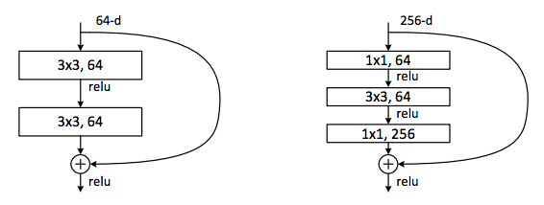
Residual Blocks and Skip Connections

Slide 25
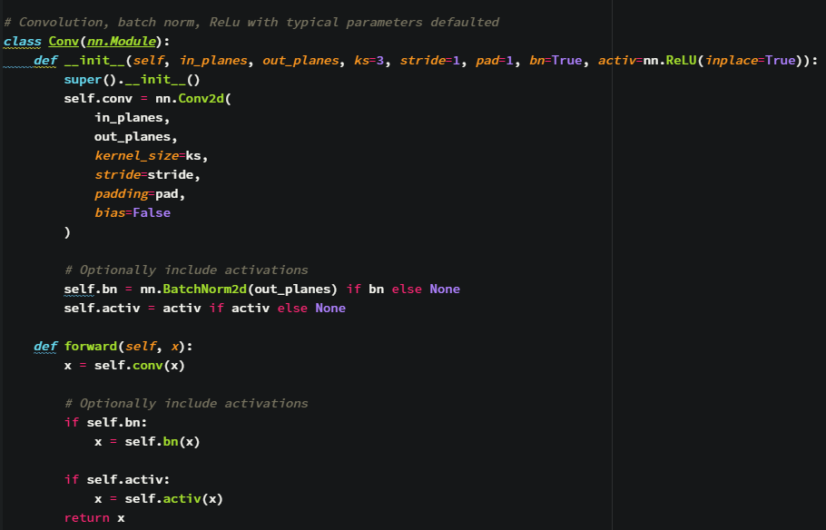
Implementing Layers in PyTorch

Slide 26
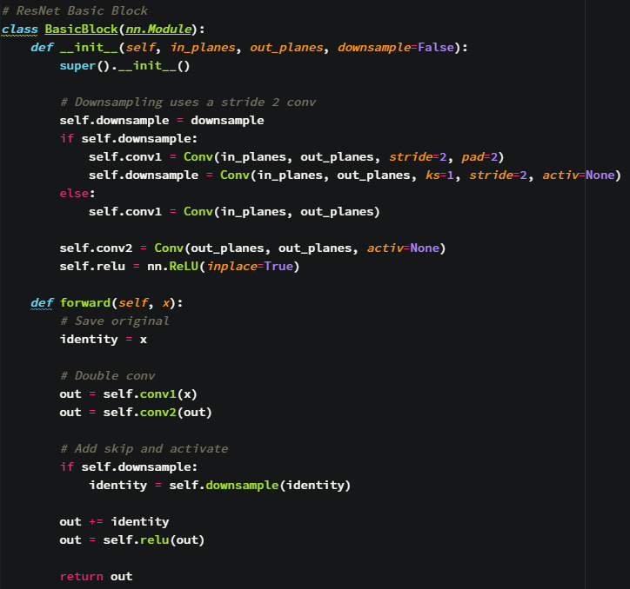
Implementing Layers in PyTorch

Slide 27
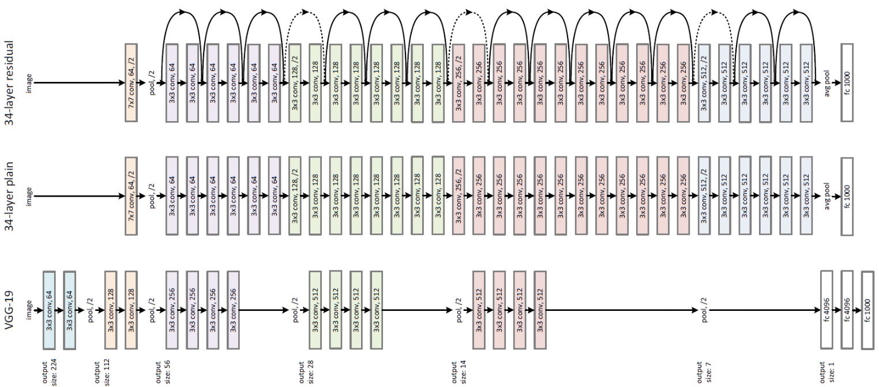
VGG vs ResNet

Slide 28
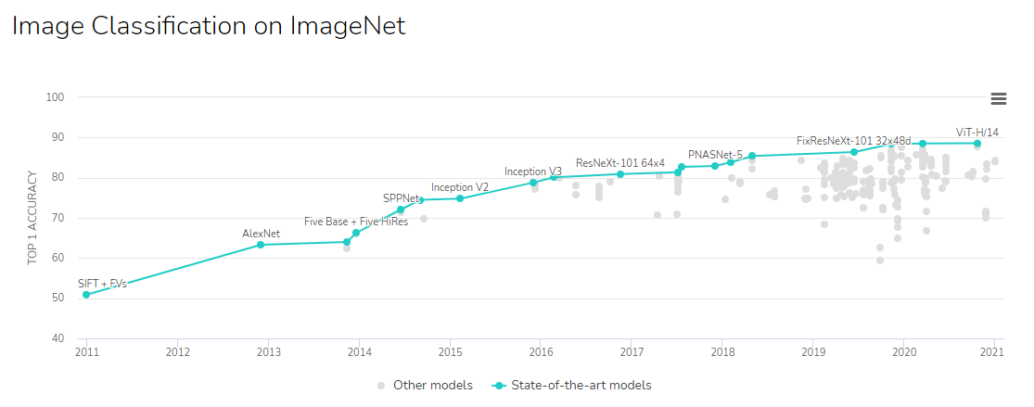

Slide 29
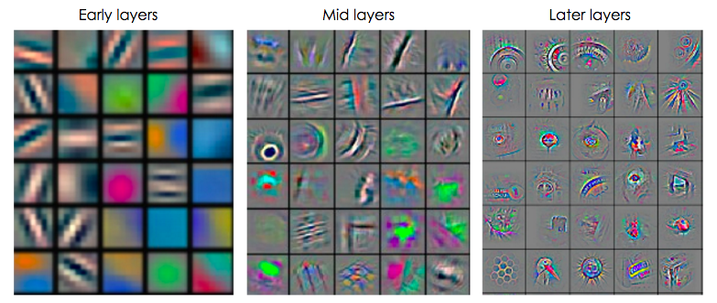
Visualising Layers of a Convolutional Neural Net
Low level features consists of simple geometrical patterns.
The higher you go, the more object-like patterns you can identify.
Low level features
High level features

Slide 30
Transfer Learning
Train on another dataset
Replace the output layers
Freeze early layers
Retrain on the new dataset
Unfreeze the early layers
Fine tune the model at a slower learning rate
Low level features
High level features

